Slide 1
Manager Books
Web Technologies and Services (CT313H)
Nguyen Thi Bich Huyen
B1910648
Semester 1, 2022-2023

Slide 2
Description of application functions
describe project
Describe project
+ The project helps to search and classify books to help ensure accuracy and science in management work, you can more easily find and update information of each book.
The functions of the application
+ Add book
+ Find book
+ Delete all books
+ Book Editing
+ Delete book
+ Login
+ Register

Slide 3
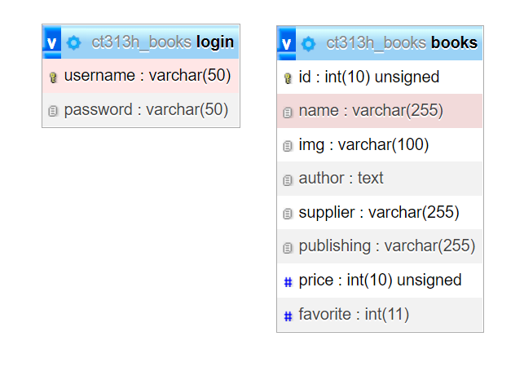
Database
Database diagram for the application

Slide 4
HTTP API
Built-in HTTP API routes
- http://localhost:3003/api/books method:GET
- http://localhost:3003/api/books method:POST
- http://localhost:3003/api/books method: DELETE
- http://localhost:3003/api/user method: GET
- http://localhost:3003/api/user method: POST
- http://localhost:3003/api/books/:id method: GET
- http://localhost:3003/api/books/:id method: PUT
- http://localhost:3003/api/books/:id method: DELETE

Slide 5
Route: http://localhost:3003/api/books method: GET
Call all data in API books and API return all information book

Slide 6
Route: http://localhost:3003/api/books method: POST
Add a new book to the API

Slide 7
Route: http://localhost:3003/api/books method: DELETE
Delete all books in the API

Slide 8
Route: http://localhost:3003/api/user method: GET
Get all login information

Slide 9
Route: http://localhost:3003/api/user method: POST
Create a new user information

Slide 10
Route: http://localhost:3003/api/books/:id method: GET
Call information by 'id' of books and API returns all information of that book id

Slide 11
Route: http://localhost:3003/api/books/:id method: PUT
Update the information by the book's id, then the API will update the change information if the data changes

Slide 12
Route: http://localhost:3003/api/books/:id method: DELETE
Delete a book by the passed id, the API will delete all the data of that book id

Slide 13
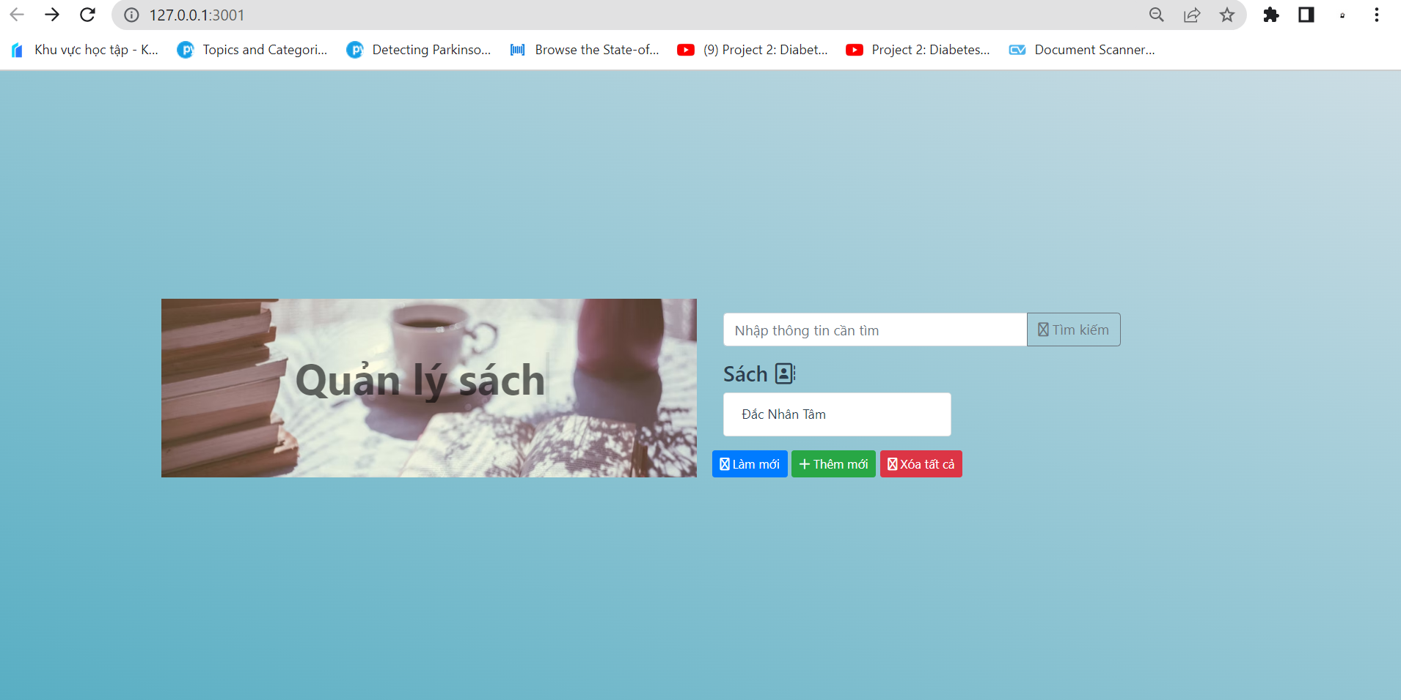
Home page

Slide 14
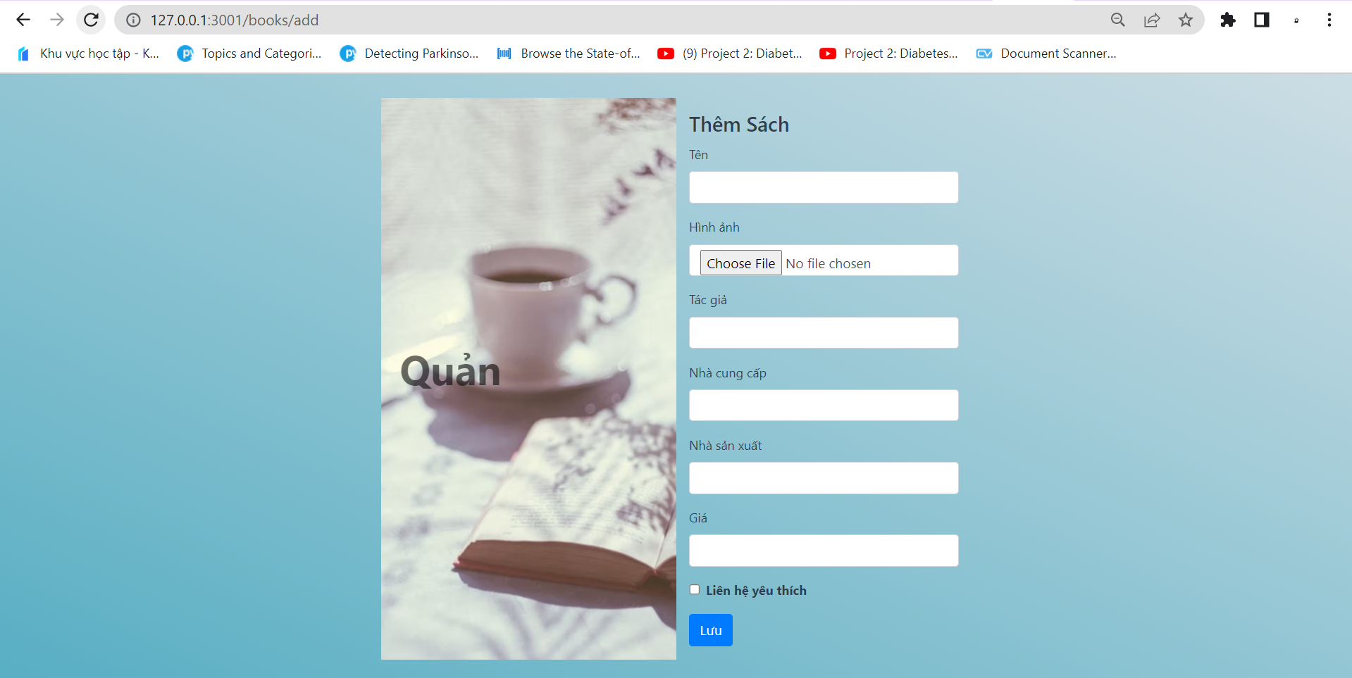
Add Books

Slide 15
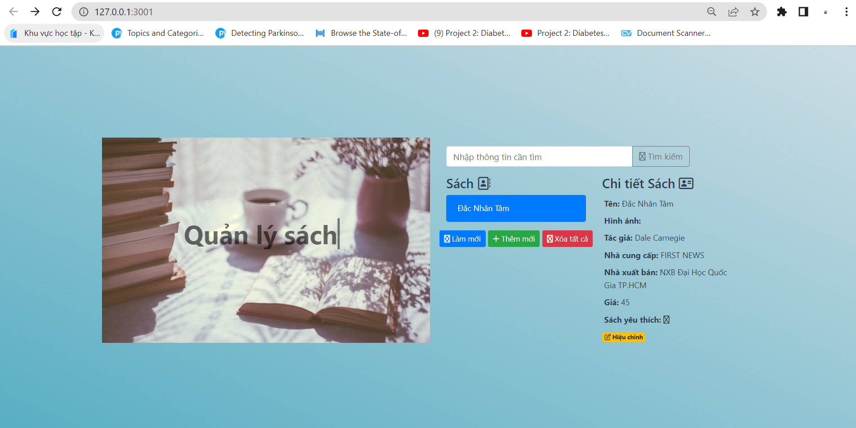
Book details

Slide 16
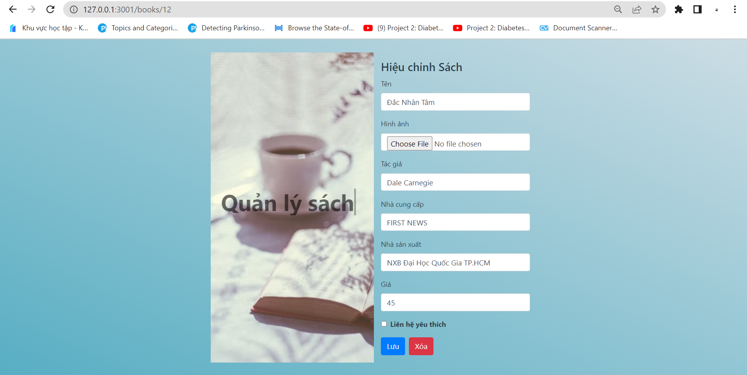
Book editing

Slide 17
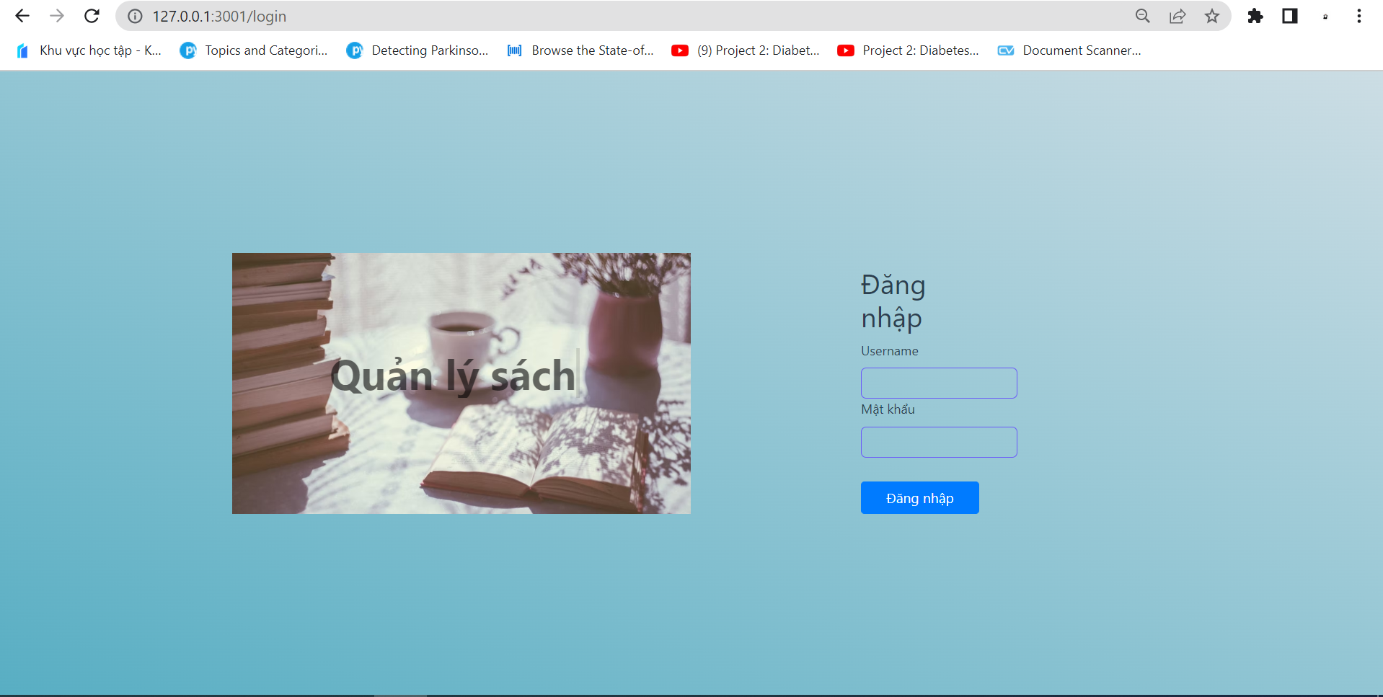
Login

Slide 18
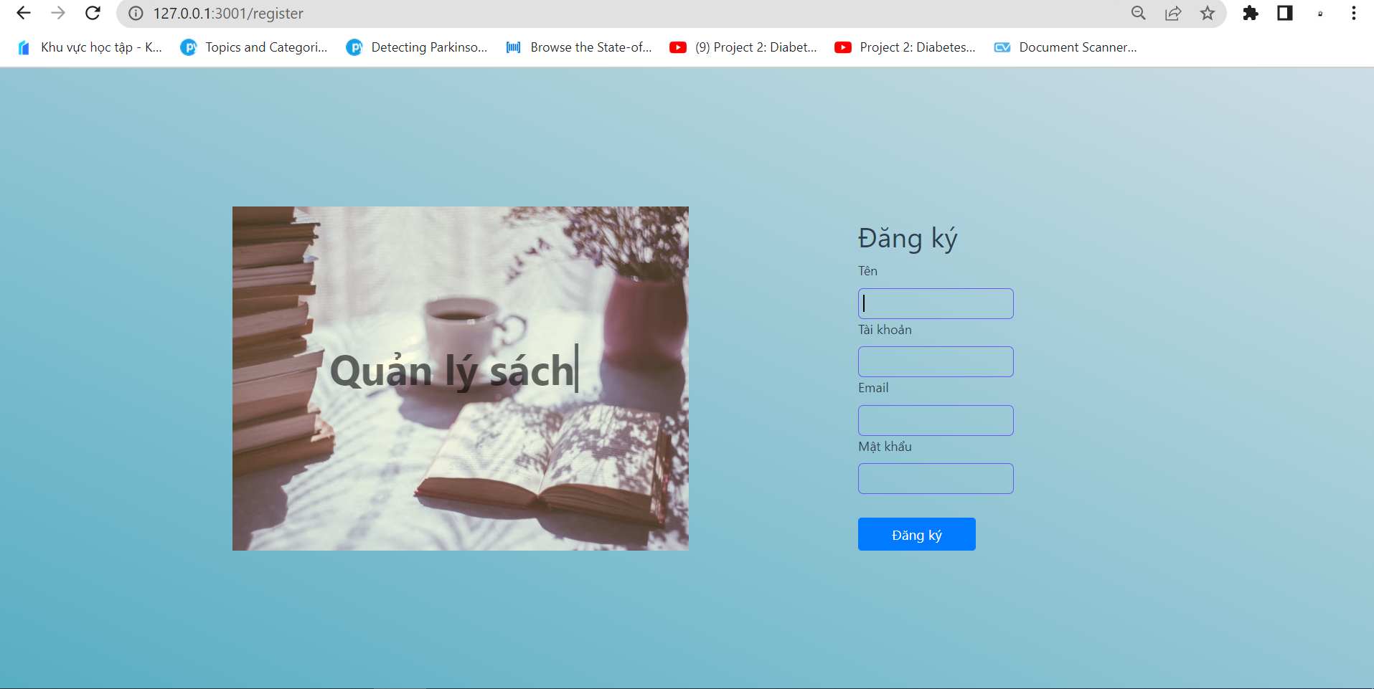
Register

Slide 19
Source code
https://github.com/HuyenHuyen2105/ManagerBooks

Slide 20
Thanks for listening!

